Slide 1
Alt coin Pro
Problem statement- Design an intelligent algorithm that leverages artificial intelligence to analyze historical data, market trends, and user preferences to provide accurate and personalized recommendations for investing in cryptocurrencies. The algorithm should adapt to dynamic market conditions and continuously improve its predictions.
By:-
Punye Batra
Utsav Joshi
Punya Jain

Slide 2
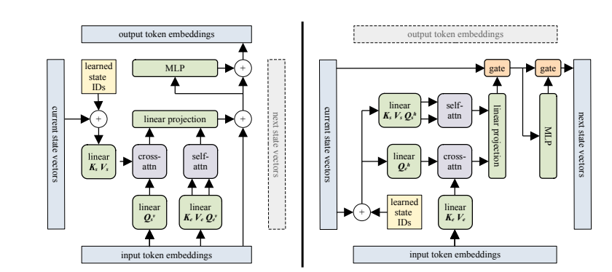
Block-Recurrent Transformers
We describe an architecture which combines the benefits of attention and recurrence. Like previous implementations of recurrence, our architecture constructs and maintains a fixed-size state, which summarizes the sequence that the model has seen thus far.
Instead of processing the sequence one token at a time, our recurrent cell operates on blocks of tokens. Within a block, all tokens are processed in parallel, at least during training. The recurrent cell likewise operates on a block of state vectors rather than a single vector. This means that the size of the recurrent state is orders of magnitude larger than in an LSTM, which dramatically improves the model’s capacity to capture the past. Processing the sequence in blocks also helps propagate information and gradients over longer distances, because the number of recurrent steps (and thus the number of times that the forget gate is applied) is orders of magnitude smaller. We show that the Block-Recurrent Transformer can remember information over distances of 60k tokens or more.
The recurrent cell itself is strikingly simple. For the most part, it consists of an ordinary transformer layer applied in a recurrent fashion along the sequence length. There are a few tricks that are necessary to stabilize training. The cost of recurrence, in terms of both computation time and parameter count, is essentially the same as simply adding one more layer to our transformer baseline. We demonstrate empirically that adding a single recurrent layer results in a much larger improvement in perplexity on multiple datasets than adding a conventional transformer layer, while training time and memory use are equivalent. Moreover, our recurrent cell is very easy to implement because it largely makes use of existing transformer code. Thus, our technique is a cheap and cheerful way to improve language modeling perplexity on long sequences.

Slide 3
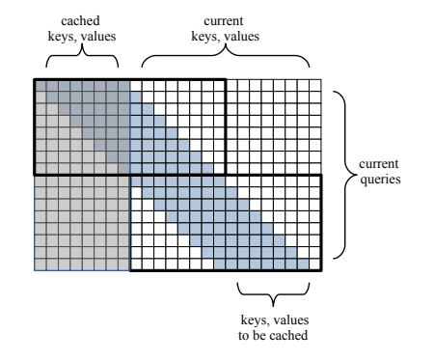
Methodology
The sliding window attention pattern . Given a segment of N tokens, the sliding window applies a causal mask in which each token can only attend to the W previous tokens, 3 where W is the window size (W = 512 in our experiments). Because of the causal mask, most entries of the N × N attention matrix are masked out (assuming that W << N). Thus, the attention computation can be optimized by breaking it into smaller tiles along the diagonal. The segment of N tokens is subdivided into blocks of size W, and each block attends locally to itself and to the previous block, so the size of each local attention matrix is W × 2W. Using this mechanism, attention is quadratic with respect to the window size W, but linear with respect to the segment length N.
Borrowing an idea from Transformer-XL, the keys and values from the last block in each segment are stored in a non-differentiable cache for use on the next training step. By using the cache, the first block in the next segment can attend to the last block in the previous segment, which extends the sliding window to cover the entire (book-length) sequence.
Note that if N = W, then sliding window attention will behave exactly like Transformer-XL; it will process and cache one segment (i.e. one block) per training step. Setting N >> W does not change the context length of attention, but it allows gradients to backpropagate across multiple blocks during training; we show that the improved differentiability provides a modest benefit to perplexity over Transformer-XL

Slide 4
Recurrent Cell
The recurrent cell receives two tensors as inputs: a set of W token embeddings, where W is the block/window size, and a set of S “current state” vectors. The cell produces two tensors as outputs: a set of W output embeddings, as well as a set of S “next state” vectors. We denote the function going from input token embeddings to output token embeddings as the vertical direction, and the function going from the current state vectors to the next state vectors as the horizontal direction. The number of state vectors S and the window size W are independent hyperparameters, but we set S = W = 512 in our experiments to simplify comparisons against baselines.
The vertical direction of the cell is an ordinary transformer layer with an additional cross-attention operation, much like a decoder layer in a standard encoder-decoder architecture . It does self attention over the input tokens, and cross-attends to the recurrent states. Unlike a typical decoder layer, we do self-attention and cross-attention in parallel. The results of both forms of attention are concatenated together and fed into a linear projection.
The horizontal direction of the cell mirrors the forward direction, except that it performs self attention over the current state vectors, and cross-attends to the input tokens. The recurrent direction also replaces the residual connections with gates, which allows the model to “forget”, an ability that is important for algorithmic tasks , or when processing long documents, where it has been central to the success of LSTMs .
Note that the presence of gates is the reason why self-attention and cross-attention are done in parallel. Doing them sequentially, as is standard practice, would introduce a third gate in the horizontal direction, which led to worse perplexity in our experiments.
Recurrence is integrated with the sliding window attention mechanism. Although not shown , each cell also receives keys and values from the previous block as input, these are concatenated with (Ke, Ve) from the current block in order to implement sliding-window attention.

Slide 5
Gate and Gate Type
Fixed gate. The fixed gate uses a learned convex combination, similar to highway networks
zt = Wzht + bz
g = σ(bg)
ct+1 = ct g + zt (1 − g)
where Wz is a trainable weight matrix, bz and bg are trainable bias vectors, σ is the sigmoid function, ct is the cell state for the current block (i.e., the state for the block at index t in the sequence of blocks), is the element-wise multiplication, and ht is the current input to the gate. In our model, ht is either the output of attention, in which case Wz is the linear projection that feeds into the gate, or ht is the output of the hidden layer of the MLP, in which case Wz is the final layer of the MLP. Unlike highway networks, the bias bg is a simple learned vector of shape R d , which is broadcast over all state vectors, where d is the state embedding dimension. The value of g does not depend on either the current value of the state vector ct, or on the current input ht, and thus remains constant (i.e., fixed) after training. The fixed gate essentially implements an exponential moving average over previous blocks.
LSTM gate. The LSTM gate uses the standard combination of input and forget gates:
zt = tanh(Wzht + bz)
it = σ(Wiht + bi − 1)
ft = σ(Wfht + bf + 1)
ct+1 = ct ft + zt it
where Wz,Wi ,Wf are trainable weight matrices, and bz, bi , bf are trainable bias vectors. The LSTM gate is strictly more expressive, because the values of ft and it depend on the current input ht. In our model, ht depends on ct, so the LSTM gate also depends indirectly on ct. LSTM gate values are thus different for each state vector, and for each block index t.

Slide 6
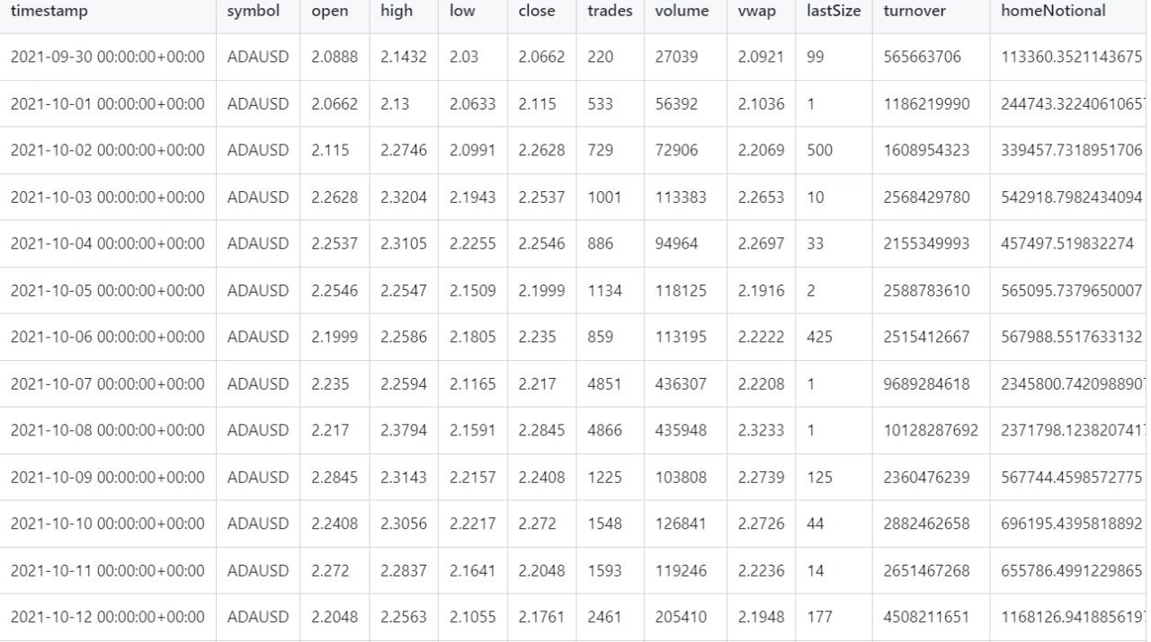
Dataset

Slide 7
THANK YOU

